Slide 1
GENDER DD INDEX : CONCEPT AND METHODOLOGY Sadou Doumbo, NDDO - Mali Malam M. Nafiou, University Abdou Mounouni - Niger Sam Agbahoungba, CREG - Senegal

Slide 2
OUTLINE
Demographic Dividend (DD) : a sustainable development opportunity
Gender mainstreaming: An imperative
A practical framework: The Gender DD Index (GDDI)
Case Study

Slide 3
The Demographic Dividend (DD) :
A sustainable development opportunity

Slide 4
The DD: The acceleration of economic growth that can occur in a country as a result of a change in the age structure of the population due to declining fertility and mortality. (Bloom, Kuhn, Prettner 2016).
Its importance is shown in international agendas (SDGs, 2063 Agenda, ICPD Action Plan, etc.)
It is based on two key pillars:
Fertility management and mortality reduction;
Size of working age population
Source of economic development: example of the East Asian economic miracle (1950 – 1990).
Notes:
Bloom et Williamson (1998) ; Barro et Sala-i-Martin (2004)

Slide 5
The DD : A Sustainable Development Opportunity
Importance of the population structure expressed through the ICPD in Cairo 1994:
It sets out population and development objectives and principles that underpinned the sustainable development goals (SDGs) adopted by UN member countries in 2015.
Imperative of taking into account all sections of the population at all ages regardless their sex and genders,
Adoption and ratification of the Convention on the Elimination of All Forms of Discrimination against Women (CEDAW): guides countries in the identification of gender equality priorities.

Slide 6
… but also by taking into account the gender.
Gender mainstreaming:
an imperative

Slide 7
Authors | Objectives | Findings
Klasen (1999) | Impact of gender inequality in education on economic growth | Gender differences in education account for between 0.4% and 0.9% of the differences in growth rates observed between countries in East Asia and those in sub-Saharan Africa and South Asia.
Mitra and al. (2015) | Impact of equal economic opportunities and equal economic and political performance on economic growth in developing and developed countries. | Out of 101 countries between 1990 and 2000, show that reducing inequality of opportunity leads to an increase in economic growth by 1.3 percentage points and an improvement in equality of participation to 1.2 percentage points..

Slide 8
Authors | Objectives | Findings
Cuberes and Teigner (2015) | Impact of gender disparities in entrepreneurship and labour market participation on productivity and per capita income | The respective exclusion of women from entrepreneurship and the labour market would lead to a 12% and 40% decline in overall per capita income productivity.
Hakura and al. (2016) | Impact of income and gender inequality on economic growth | GDP per capita in the countries of Saharan Africa could increase by 0.9 percentage points with a decrease in gender inequality to the level of inequality observed in Asian emerging countries.
Dramani and al. (2015) | Contribution of unpaid domestic work | Domestic work per day: 7 hours for women and 30 minutes for men in Senegal

Slide 9
GDDI Methodology
(Gender Demographic Dividend Index)

Slide 10
Gender DD Index?
A tool for analyzing the country's progress in reducing gender disparities in DD capturing efforts
It is derived from DDMI and therefore has DD as an entry point.
It reveals both the facts about gender bias and the contribution of women and men to the DD capture process.
Notes:
GDDI n’est pas juste un indice genre supplémentaire comme les autres

Slide 11
Gender DD Index?
It is based on the five dimensions of DDMI ...
... most of the indicators are gender-specific.

Slide 12
The GDDI:
List of elementary indicators

Slide 13
Components of Dimension 1
Indicators | Types | Sources
Education consumption | Gender-specific | Survey & National accounts
Health consumption | Gender-specific | Survey & National accounts
Other consumptions | Gender-specific | Survey & National accounts
Wage income | Gender-specific | Survey & National accounts
Self-employment income | Gender-specific | Survey & National accounts
Population by age | Gender-specific | Census or Survey
Source: CREG 2019

Slide 14
Components of Dimension 2
Sub dimensions | Indicators | Types | Sources
Civic engagement and governance | Electoral participation | Gender-specific | Electoral commission
 | Stakeholder participation in the development of laws and regulations | Non-diff. | WDI
Social network | Quality of the social network | Gender-specific | Survey
Environment | Air Pollution | Non-diff. | Atmospheric Survey Center
 | Quality of water | Gender-specific | Survey
Housing conditions | Number of rooms per person | Gender-specific | Survey
 | Access to basic sanitation facilities | Gender-specific | Survey
 | Cost of housing | Gender-specific | Survey
Subjective well-being | Satisfaction with life | Gender-specific | Survey
Professional work and private life balance | Number of hours of heavy work | Gender-specific | Survey
 | Time for leisure and self-care | Gender-specific | Survey
Security | Feeling of security when walking alone at night | Gender-specific | Survey
 | Homicide rate | Gender-specific | GPI; Administrative sources

Slide 15
Components of Dimension 3
Sub dimensions | Indicators | Types | Sources
Stable state | Poverty trap | Gender-specific | Survey
 | No poverty | Gender-specific | Survey
Transitional state | Exit from poverty | Gender-specific | Survey
 | Shifting into poverty | Gender-specific | Survey
Source: CREG 2019

Slide 16
Components of Dimension 4
Sub dimensions | Indicators | Types | Sources
Health | Life expectancy | Gender-specific | Census
 | Total fertility rate | Non-differentiable | DHS
Education | Average length of schooling | Gender-specific | Survey
 | Expected duration of schooling | Gender-specific | Survey
Living standards | Consumption per capita | Gender-specific | Survey
Source: CREG 2019

Slide 17
Components of Dimension 5
Sub dimensions | Indicators | Types | Sources
Urbanization | Population density | Gender-specific | Survey/ Census
 | Average size of households | Gender-specific | Survey/ Census
 | Urbanization rate | Gender-specific | Survey/ Census
 | Ratio of renter households to owner households | Gender-specific e | Survey/ Census
Migration | Entry index | Gender-specific | Survey/ Census
 | Exit index | Gender-specific | Survey/ Census
Infrastructure and basic social services | Index of access to infrastructure and basic social services | Gender-specific | Survey
 | Quality index of infrastructures and basic social services | Gender-specific | Survey
Financial flows | Cost of the basket of housewives in the region | Gender-specific | Survey
 | Rate of access to formal transfer services | Gender-specific | Survey
 | Consumption per capita | Gender-specific | Survey
Source: CREG 2019

Slide 18
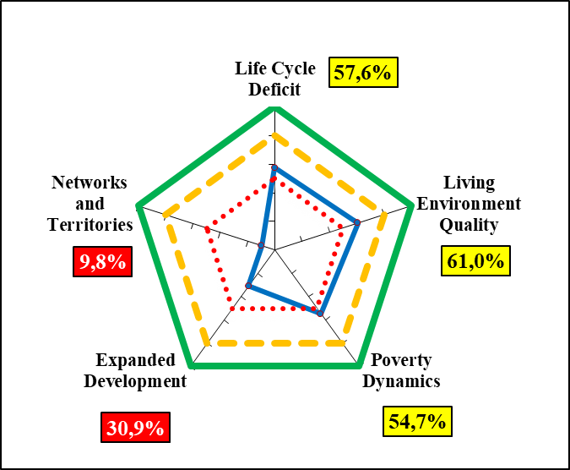
DDMI - NIGER
DDMI= 36,1%
Legend :
< 50%
50% - 79%
>=80%
Source: CREG 2020

Slide 19
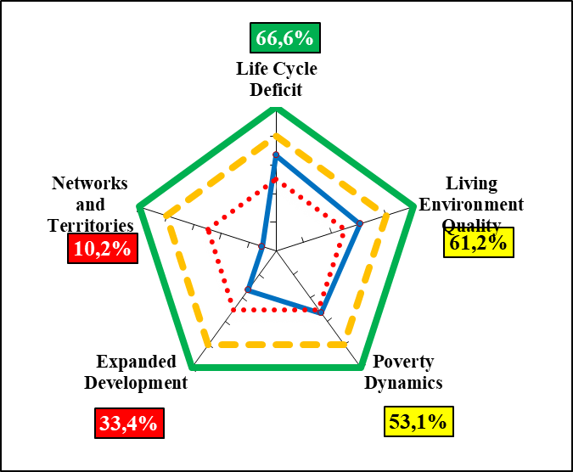
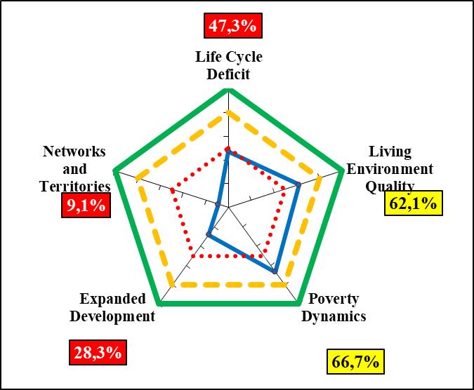
Gender DD Index - NIGER
MEN
WOMEN
GDDI_Men = 38,0%
GDDI_Women = 34,8%
Source: CREG 2020

Slide 20
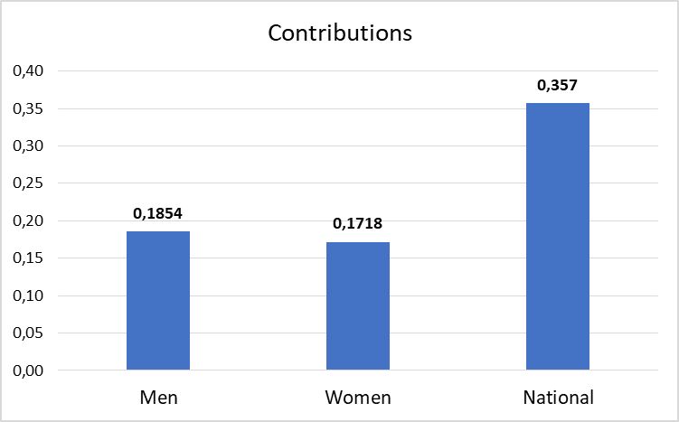
Contributions to DD
Men’s share: 52%
Woemn’s share: 48%
Men’s contribution: 0,188
Women’s contribution: 0,172
Source: CREG 2020

Slide 21
THANK YOU

